Slide 1
The Jaws of Time
Garrett Stonis

Slide 2
Table of Contents:
Overview of the Universe
Demigods, Gods, Titans, and the Creator
16-32: Story Beats
19-28: Random Encounters
34-40: Possible Endings

Slide 3
Basic Introduction
Welcome to the land of Yultaria: The Best Country of the Material Plane! If you weren’t lucky enough to be born here, then you likely arrived from one of our world-class ports! Was it

Slide 4
Places
Urtonburg, Northwood, and more.

Slide 5
Yultaria
The richest and largest country on Stromea, Yultaria is one of the trade capitals of the world. Boasting an impressive navy, Yultaria is ruled by only one kingdom, under King Rupert. King Rupert is more of a militaristic leader, despite Yultaria not being at war for many decades.
Yultaria is rich in forest and minerals, exporting lumber, iron, coal, precious metals, and more. Yultaria is also home to the largest steel company in the world, Orebraid Steel. Due to the near monopoly of Orebraid, finding another source of steel can be rather difficult, and trying to start your own business can be risky as Orebraid’s men are very likely to sabotage. Norman Orebraid (a cloud giant), the current owner, is a ruthless businessman, owning every mine on the Southeast coast. The capital of the steel world is near these mines in the Eastgough Peaks, a city called Dhordarum.
Most of Yultaria is covered in forest and grasslands, with marshlands at the very south and mountains to the southeast. The northern-most parts of Yultaria are snowy taiga forests.

Slide 6
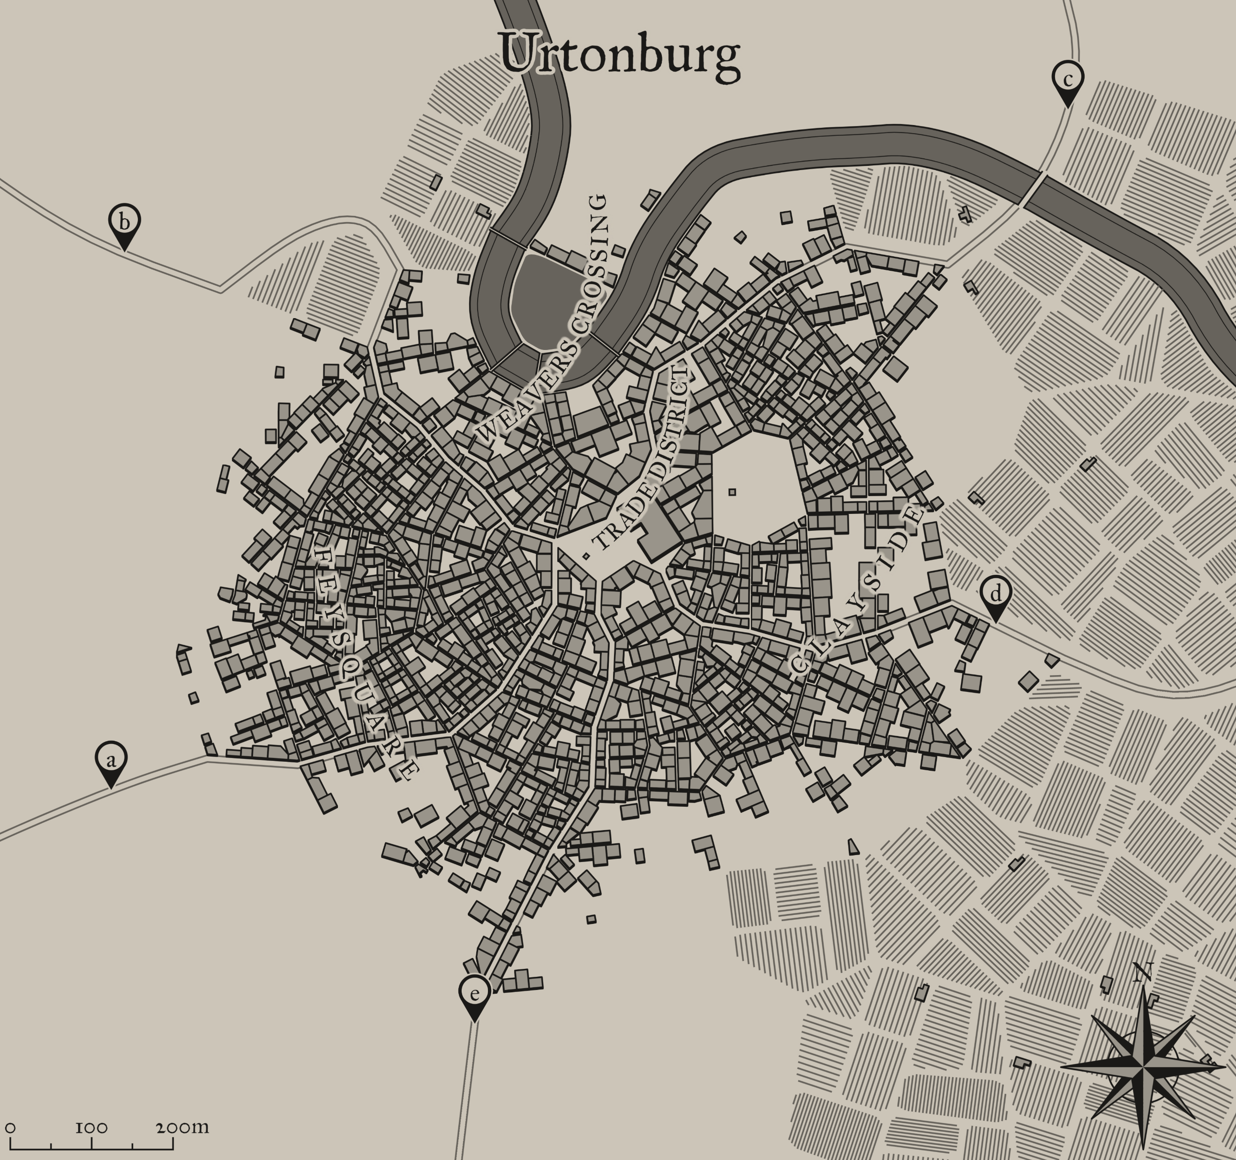
Urtonburg
Amastacia Ave.
Eterna Rd.
Ruby St.
Barley St.
South St.

Slide 7
Urtonburg - Overview
Old Capital
10,000 citizens
15% human, 30% elf (and half elf), 35% dwarf, 10% halfling, 5% half orc, and 5% various other races
The Nobles
10 peeps, all human but Mythanar Philynn (elf arch-mage) and Goteam Chainmace (dwarf)
Trade District
All kinds of shops, convenient but expensive, home to Ganalow Gardens
Weaver’s Crossing
South-side is the human population, north-side (above river) is governing bodies
Feysquare
Home to elf population, magic shops and wineries
Clayside
Home to dwarves (and half orcs), Cinderena
Farmland
Where most of the halflings live, make money by selling wheat, carrots, potatoes, meats, and ale

Slide 8
Urtonburg (cont.)
The old capital of Yultaria, Urtonburg is the most populated city at nearly 10,000 citizens. If you include traders and travelers, then the population easily surpasses 10k. The population is roughly split at 15% human, 30% elf (and half elf), 35% dwarf, 10% halfling, 5% half orc, and 5% various other races. Most of the races stick to their respective districts but will very commonly meet in the Trade District.
While most of the population is dwarf, the city is actually run almost entirely by humans. Urtonburg is run by a committee of 10 nobles that are appointed directly by King Rupert. The only elf and dwarf on the committee are Mythanar Philynn and Goteam Chainmace, respectively. Mythanar was appointed due to his brilliance in the arcane arts, while Goteam was a “request” by the Orebraid family.
Urtonburg is split into 4 districts: Weaver’s Crossing, Feysquare, Clayside, and Trade.
The Trade District is the simplest of all, it is entirely made up of commercial buildings. Anything from basic magic shops to the finest blacksmiths in the land can be found here. While super convenient and easy to find, many of the shops raise their prices to quite an annoying degree at times. Other shops exist in other districts. There is also a really nice park here called the Ganalow Gardens.

Slide 9
Urtonburg (cont.)
Weaver’s Crossing, named after the late Damien Weaver, is the governing district. Here, all city-wide political decisions are made, the Nobles live there, and the royal guard have a station there. Much of Weaver’s Crossing is inaccessible to the public without invitation. Sneaking around there without the proper paperwork is fiercely punishable in court; death in extreme cases.
Feysquare is home to the elf population in Urtonburg, with a strict border on South St. On average, Feysquare is a bit more cramped than the rest of the city; most housing is rented and only a few feet apart. Fires would be common weren’t it for the tendency of elves to be more magical. There is a decent mix of high elf and wood elf present, both making up roughly 50% of the elf population. The shops here are almost entirely magic and wineries.
Clayside is the dwarvern (and half orc) district of Urtonburg, also strictly bordered with South St. Clayside is mostly a residential area, but there is a decent amount of front business for the Orebraid Steel company. That is to say there are plenty of blacksmiths and offices in the area. The more lively taverns tend to be here. Clayside is home to the Cinderena, the largest arena in Yultaria. Many gladiator, chariot, and sport battles are held here.

Slide 10
Urtonburg (cont.)
The rural farmlands to the east of the city house most of the halflings in the city. They make a living by selling wheat, carrots, potatoes, beef, pork, and chicken. The dwarves are definitely the richer ones in the city due to Barley St. going directly into Clayside before it reaches the Trade District. Most of the ale is made in privately-owned distilleries here.

Slide 11
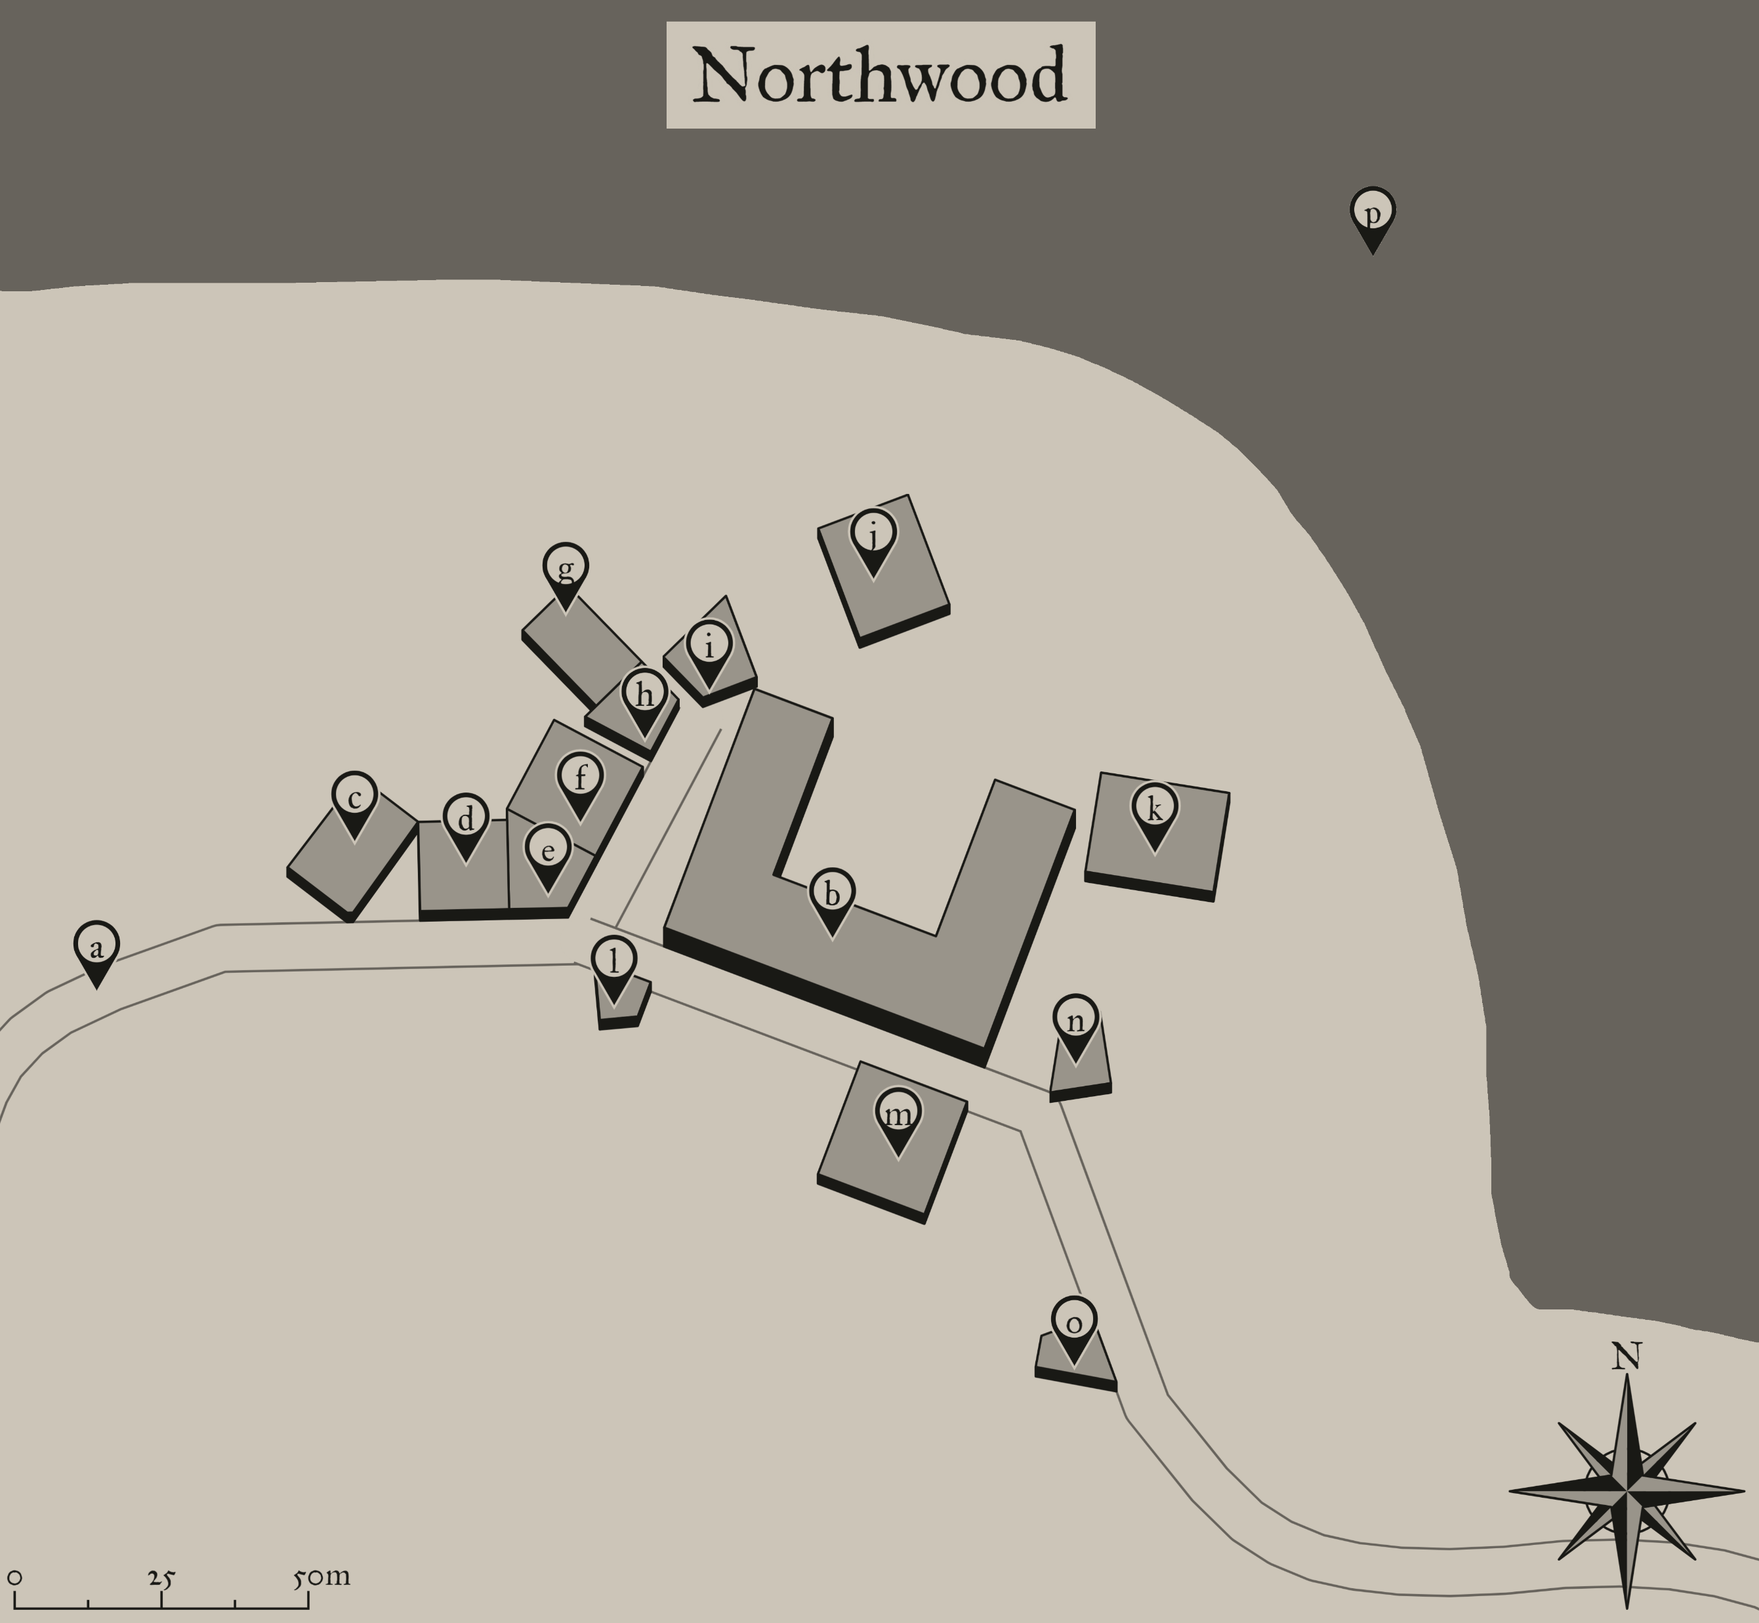
Northwood
Eterna Rd.
Temple of Gond
The Innterna
Innterna Stables
The Corner Store
The Hot Hammer
Orebraid High
Orebraid Steel
The Oak
Orebraid Steel Coal Mine
Northwood Detention Center
Solace Spire
Town Hall
Cliffhammer House
The Dusty Tome
Eterna Forest

Slide 12
Northwood - Overview
Description: As you make your way down the road, you hear church bells ring in the distance. Not too long after, you pass a bend in the road and see a small town nestled up to the forest. A stone temple with a single steeple dominates the area; people are just leaving the building as you set foot in the town borders.
Northwood is a small town 48 miles (2 days) north of Urtonburg. Northwood is situated directly next to Eterna Forest. The population will be determined as characters are made.
Northwood’s main objective as a town is to ferry the coal mined at the Orebraid Steel Coal Mine to Urtonburg. The town has only just begun to grow, and therefore the current mining situation is slow and inefficient.

Slide 13
Temple of Gond
Description: A large stone temple stands before you. The walls are a perfectly symmetrical array of polished granite bricks, smooth to the touch. Smooth marble steps lead you up to a large oak door with fine brass handles. An alabaster gear approximately 5ft. tall hangs over the door supported by 2 steel wires that reach up into the building. A single steeple reaches high into the sky with a large, shiny brass bell stored above.
Height: 30ft. (Steeple is 50ft.)
Residents: Father Lulmick, Durnurtha Brighthelm
DM Details:
DC 15 locks are used on all doors at night
Mass is held every week [Make calendar]
Lobby, West Wing, East Wing, Storage

Slide 14
Temple of Gond
Description: A large stone temple stands before you. The walls are a perfectly symmetrical array of polished granite bricks, smooth to the touch. Smooth marble steps lead you up to a large oak door with fine brass handles. An alabaster gear approximately 5ft. tall hangs over the door supported by 2 steel wires that reach up into the building. A single steeple reaches high into the sky with a large, shiny brass bell stored above.
Height: 30ft. (Steeple is 50ft.)
Residents: Father Lulmick, Durnurtha Brighthelm
DM Details:
DC 15 locks are used on all doors at night
Mass is held every week [Make calendar]
Lobby, West Wing, East Wing, Storage
Lulmick cleric, Dur Paladin, West Wing chapel, East Wing maker shop, Storage is 2nd floor of lobby, Storage reaches to bell tower

Slide 15
Steelgulch
Small mining town near Dhordarum. Literally only exists because I loved the name.

